Slide 1

Tuesday

Slide 2


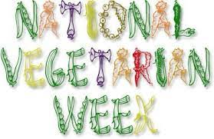
Spiritual, Moral, Social and Cultural Development (SMSC)
Awareness Days this week…
Click on the images or links for more information or activities.
Activities - Primary
Activities
Test your Numeracy - Secondary
Benefits of being Vegetarian

