Slide 1
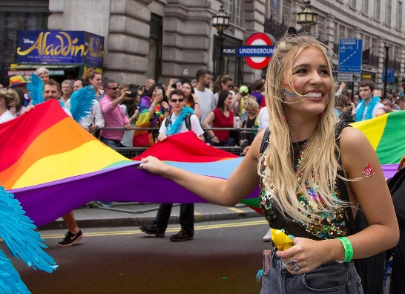
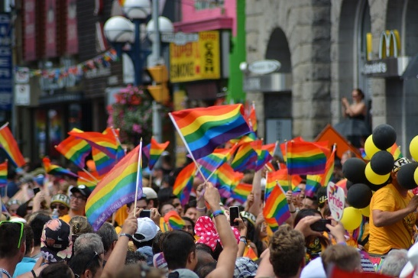
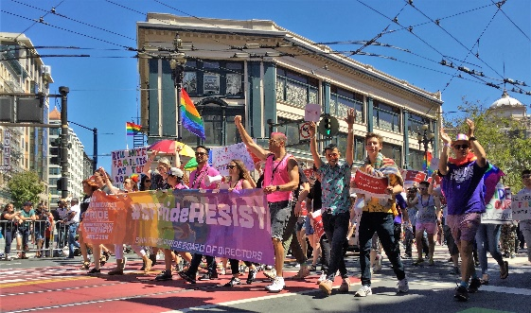
Pride Month June 2024

Slide 2
LINKED ARTICLES
Many articles are relevant to explore when celebrating LGBT+ History Month but this pack focusses on following:
Article 2: (non-discrimination) The Convention applies to every child without discrimination, whatever their ethnicity, gender, religion, language, abilities or any other status, whatever they think or say, whatever their family background.
Article 13: (freedom of expression) Every child must be free to express their thoughts and opinions and to access all kinds of information if it is within the law.
Article 17 - access to reliable information Every child has the right to reliable information from a variety of sources, and governments should encourage the media to provide information that children can understand. Governments must help protect children from materials that could harm them.
And remember, at the heart of the UN Convention on the Rights of the Child are the values of dignity, equality and non-discrimination.

Slide 3
What is Pride Month?
Pride Month is a special time when people all around the world celebrate the LGBTQ+ community. It is a month dedicated to recognizing and honoring the diversity of sexual orientations and gender identities. During Pride Month, there are events, parades, and activities that promote equality, acceptance, and understanding. It's a time when people come together to show support and love for everyone, regardless of who they love or how they identify themselves. It's all about spreading kindness, respect, and celebrating the unique qualities that make each person special.

Slide 4
What is Pride Month?
Click the image to watch a video about Pride
2 minutes
Additional link to video: https://youtu.be/4QuqSB-r9rI

Slide 5
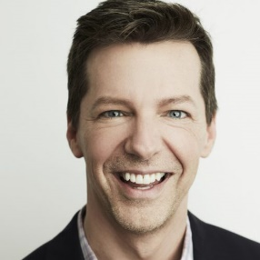
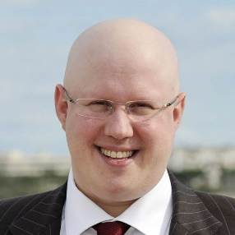
Pride Month 2023: LGBTQIA+ role models
Here are some LGBTQIA+ role models who have self-identified as being a part of the LGBTQ community. Does anybody recognise any of these faces?

Slide 6
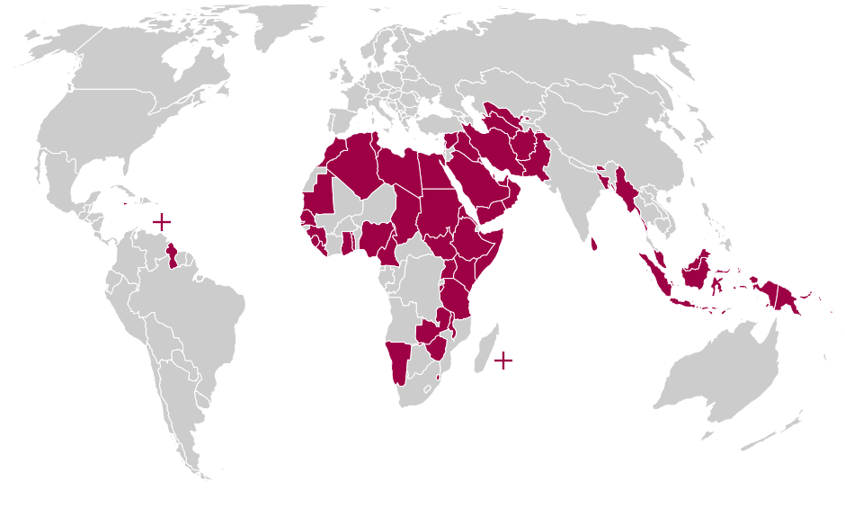
Pride Month: LGBTQIA+ around the world
Despite progress in LGBTQIA+ rights in some countries, discrimination, violence, and persecution based on sexual orientation and gender identity are still widespread in many parts of the world. Homophobia, transphobia, and biphobia manifest in various forms, such as hate speech, hate crimes, exclusion from public life, and denial of basic human rights.
Countries where LGBTQIA+ is illegal

Slide 7
Pride Month: Be an LGBTQIA+ ally
As a teenager, you may have friends or family members who identify as LGBTQIA+, or you may meet people in your community who identify as LGBTQIA+. By being an ally, you can help create a safe and welcoming environment for these individuals and show them that they are not alone.
Being an ally also means standing up against discrimination and hate speech when you see it and using your voice to promote understanding and acceptance. It means being an advocate for policies and laws that protect the rights of LGBTQIA+ people and supporting organizations that provide resources and services to the LGBTQIA+ community.
In short, being an ally means being a good friend, neighbor, and citizen, and helping to make the world a better, more inclusive place for everyone.

Slide 8
Pride Month: How to be an LGBTQIA+ ally
Educate yourself
Learn about the experiences, struggles, and issues faced by LGBTQIA+ individuals. This can include reading books, watching movies or documentaries, and researching online. Watch online media that supports ally work.
Watch ‘Shh! Silence Helps Homophobia’ :7 minutes
Click image to start video or alternatively use this link: https://youtu.be/XQKGigb5l28
Notes:
https://youtu.be/XQKGigb5l28

Slide 9
Pride Month: How to be an LGBTQIA+ ally
Speak Up
If you hear someone making derogatory comments or jokes about LGBTQIA+ individuals, speak up and let them know that it is not okay. Stand up against bullying, discrimination, and hate speech.

Slide 10
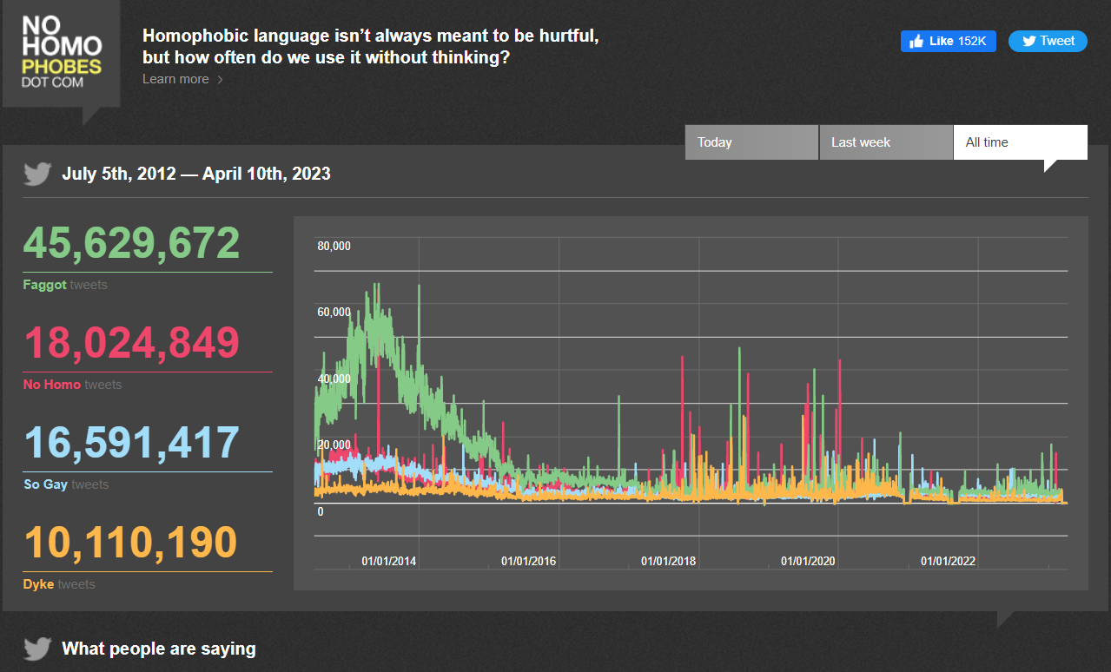
Pride Month: How to be an LGBTQIA+ ally
Language matters
Use correct and inclusive language. Language such as ‘lezzer’ and ‘gay boy’, as well as ‘gay’ as a term of disapproval of someone or something, must be challenged in each and every instance to send the message that homophobic language is unacceptable.
Use this website to see how homophobic language is still happening in our social media settings. Click image to access

Slide 11
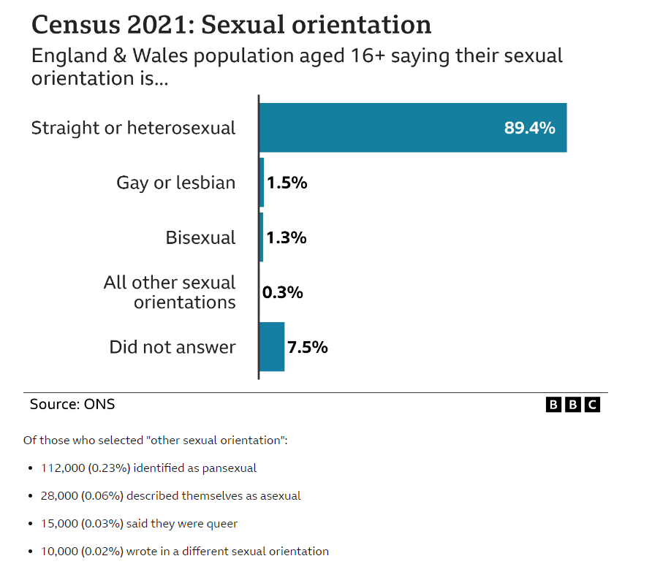
Pride Month: How to be an LGBTQIA+ ally
Be sensitive to those around you
Don’t assume everyone you talk to is straight. Someone close to you may be struggling with coming out. Not making assumptions will make things easier for them.
Remember, nearly 1 in 10 of people who completed the 2021 census identified as LGBTQIA+. You will know people well who have already come out or will do in the future. Be sensitive to this.

Slide 12
Pride Month: How to be an LGBTQIA+ ally
Confront your own prejudice and bias
Being an ally means you will often find that you need to challenge any bias, stereotypes, and assumptions you didn't realise you had.
Think about the jokes you make, the pronouns you use and if you wrongly assume someone's partner is of a particular sex or gender just because of the way they look and act.
LGBTQIA+ prejudices can be subtle and transphobia and biphobia exist even within the LGBTQIA+ community. Being a better ally means being open to the idea of being wrong sometimes and being willing to work on it.

Slide 13
Pride Month: How can schools and students celebrate and support LGBTQIA+ individuals and communities in school?
CURRICULUM
VOICE
CELEBRATE
Include positive representation of LGBTQIA+ individuals, history, and issues. This can help to create a more supportive and accepting environment for LGBTQIA+ students.
Create a LGBTQIA+ club, organizing events, start a social media campaign or influence school policies. These initiatives can help to give you a voice and empower you to make positive change.
Celebrate LGBTQIA+ events such as Pride Month or Transgender Day of Visibility to show support for the LGBTQIA+ community and promote awareness and acceptance.
FACILITIES
FAMILY
TRAINING
Create gender-neutral facilities such as bathrooms and changing rooms to ensure that all students feel safe and included.
If you have friends or family members who identify as LGBTQIA+, support them and be there for them. Listen to their stories, respect their identities, and be an ally in their journey.
All members of the school community should be trained on how to support LGBTQIA+ students, including how to address bullying, use inclusive language

Slide 14
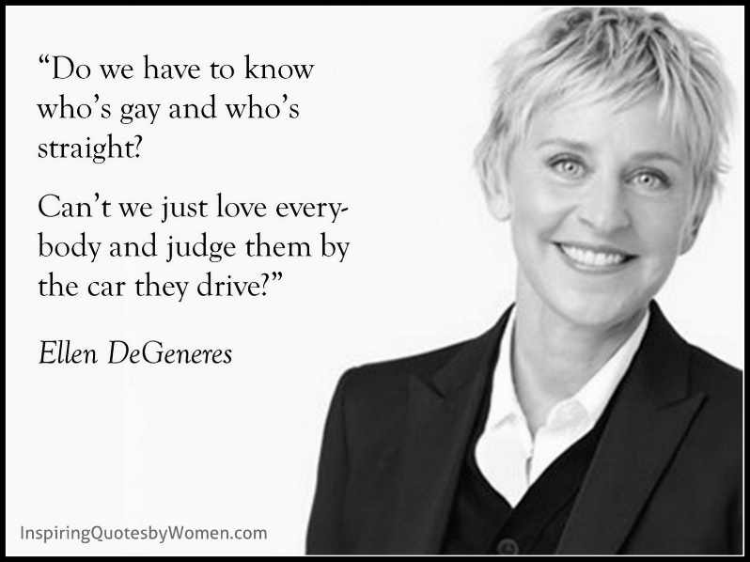
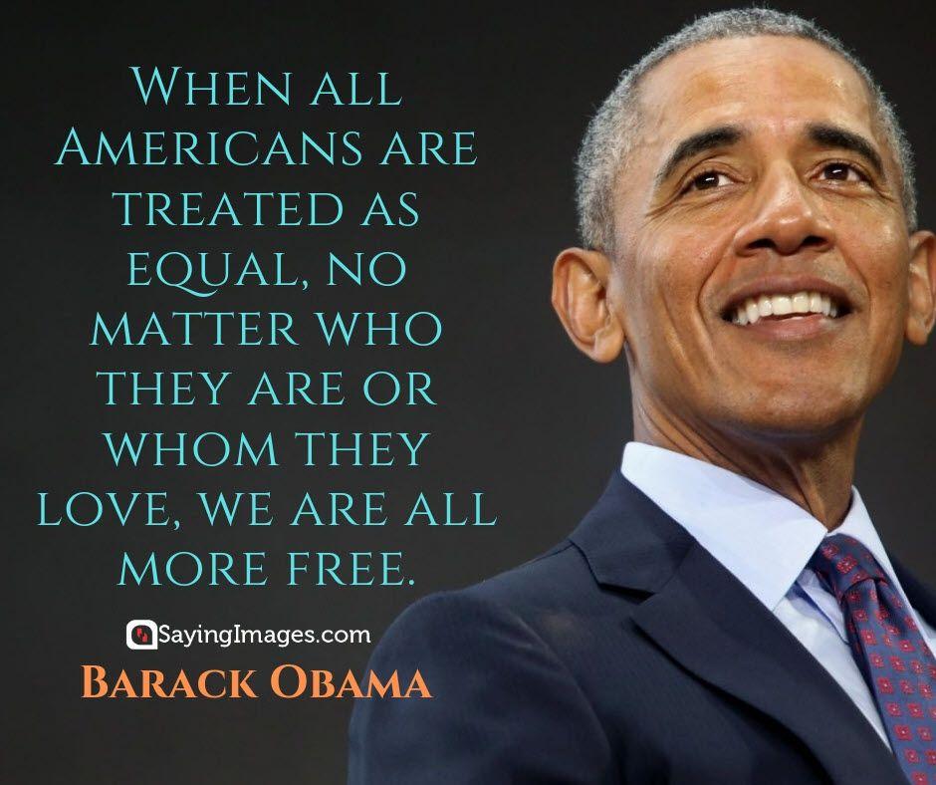
Pride Month final thoughts: it starts with you and your actions and words

Slide 15
Pride Month: Form Time Activities
Follow-up form time activities

Slide 16
Pride Month: Form Time Activities
Follow-up form time activities: Colouring

Slide 17
Pride Month: Form Time Activities
Follow-up form time activities: Wordsearch
PRIDE MONTH WORDSEARCH
NAME:
DATE:
CLASS:
TEACHER:

Slide 18
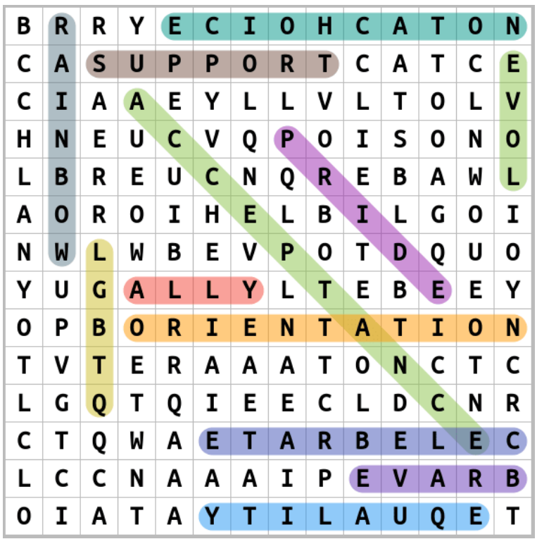
Pride Month: Form Time Activities
Follow-up form time activities: Wordsearch Solution
PRIDE MONTH WORDSEARCH
NAME:
DATE:
CLASS:
TEACHER:

Slide 19
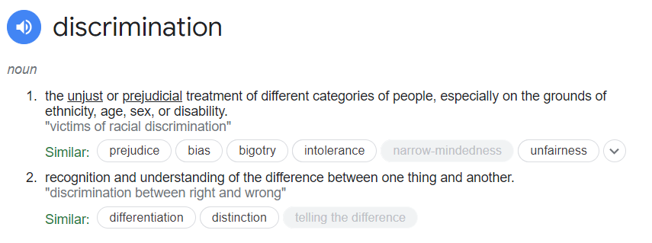
Pride Month: Form Time Activities
Follow-up form time activities: The Discrimination Game
Inform students that you will be looking at how people are occasionally handled based on certain aspects of their identification.
All pupils with blue eyes in the room should stand up and move to the rear of the room so they are facing the wall. In order to elicit a response, clarify that this is a new Government seating plan.
What does it feel like to receive such treatment? Was it just? What word best defines this form of medical care? (Seeking DISCRIMINATION as the solution).

Slide 20
Pride Month: Form Time Activities
Follow-up form time activities: The Discrimination Game
Ask them if they can think of any reasons why some people would discriminate against others because they were LGBTQIA+. Ask students if they can think of any reasons why people would discriminate against others based on a trait they are unable to change.
To make suggestions, students may put up their hands or write them down. If the students do record their responses in writing, it is crucial that you go around the class and collect them because some kids might feel awkward disclosing their responses. Then you can ask the group if anyone feels comfortable telling the class about their responses. You must make sure to let the class know about any traits, such as sexual orientation, gender identity, race, religion or belief, disability, sex, and age, if they are not spoken or recorded.

Slide 21
Pride Month: Form Time Activities
Follow-up form time activities: Watch a more detailed film
Watch BBC News from 2022 – How Pride in the UK was born
Click image to view video or click this link: https://youtu.be/6USqIsRY6cM
11 minutes
Notes:
https://youtu.be/6USqIsRY6cM

Slide 22
Pride Month: Form Time Activities
Follow-up form time activities: Design a poem about LGBTQIA+
You could design a poem about being a teenager who is LGBTQIA+ or an ally. The poem could even be an acrostic poem. Examples are on the next couple of slides ☺

Slide 23
Pride Month: Form Time Activities
Follow-up form time activities: Example LGBTQIA+ poem
I am a teenager, full of hope and dreams,
But my heart is heavy, my life's not what it seems,
For I am different, I don't fit the mold,
My love is not what society has told.
I am LGBT+, and proud to be,
But the world around me, it cannot see,
The struggles that I face each day,
As I try to live and find my way.
The weight of labels and judgment so severe,
Makes me feel invisible, it's hard to bear,
The pain of rejection, the fear of hate,
Makes me want to hide, to escape my fate.
But I am strong, I know who I am,
I will not let the world tell me I am wrong,
For love is love, it knows no bounds,
And my heart will soar, unchained, unbound.
I am a teenager, full of hope and light,
And though the road may be long and fight,
I know that one day, the world will see,
That I am just as worthy, just as free.
So let me live, let me love,
Let me be who I was born to be,
For I am a LGBT+ teenager,
And I am proud, I am free.

Slide 24
Pride Month: Form Time Activities
Follow-up form time activities: Example acrostic LGBTQIA+ poem
Lived in fear for so long,
Going through life feeling wrong,
But then I found my community,
Truly accepting of who I can be.
Queer is my identity,
I won't hide it or let it be,
And I'll fight for the rights of all.

Slide 25
Pride Month: Form Time Activities
Follow-up form time activities: Form time quiz 1
What does the "B" stand for in LGBTQIA+?
a) Bisexual
b) Binary
c) Belonging
What does the "I" stand for in LGBTQIA+?
a) Intersex
b) Intuitive
c) Independent
What is the difference between sex and gender?
a) There is no difference
b) Sex refers to biological characteristics, while gender refers to cultural and social roles and expectations
c) Gender refers to biological characteristics, while sex refers to cultural and social roles and expectations

Slide 26
Pride Month: Form Time Activities
Follow-up form time activities: Form time quiz 1 Answers
What does the "B" stand for in LGBTQIA+?
a) Bisexual
b) Binary
c) Belonging
What does the "I" stand for in LGBTQIA+?
a) Intersex
b) Intuitive
c) Independent
What is the difference between sex and gender?
a) There is no difference
b) Sex refers to biological characteristics, while gender refers to cultural and social roles and expectations
c) Gender refers to biological characteristics, while sex refers to cultural and social roles and expectations

Slide 27
Pride Month: Form Time Activities
Follow-up form time activities: Form time quiz 2
What does the term "coming out" mean?
a) Admitting to a crime
b) Sharing one's LGBTQIA+ identity with others
c) Going out to a party with friends
What is the purpose of Pride Month?
a) To celebrate LGBTQIA+ rights and visibility
b) To encourage discrimination against LGBTQIA+ people
c) To discourage people from being LGBTQIA+
What is the difference between sexual orientation and gender identity?
a) There is no difference
b) Sexual orientation refers to biological characteristics, while gender identity refers to attraction to people of the same or different gender
c) Gender identity refers to one's internal sense of being male, female, both, or neither, while sexual orientation refers to attraction to people of the same or different gender

Slide 28
Pride Month: Form Time Activities
Follow-up form time activities: Form time quiz 2 Answers
What does the term "coming out" mean?
a) Admitting to a crime
b) Sharing one's LGBTQIA+ identity with others
c) Going out to a party with friends
What is the purpose of Pride Month?
a) To celebrate LGBTQIA+ rights and visibility
b) To encourage discrimination against LGBTQIA+ people
c) To discourage people from being LGBTQIA+
What is the difference between sexual orientation and gender identity?
a) There is no difference
b) Sexual orientation refers to biological characteristics, while gender identity refers to attraction to people of the same or different gender
c) Gender identity refers to one's internal sense of being male, female, both, or neither, while sexual orientation refers to attraction to people of the same or different gender

Slide 29
Pride Month: Form Time Activities
Follow-up form time activities: Form time quiz 3
What are some common challenges faced by LGBTQIA+ youth?
a) Acceptance from family and friends
b) Legal protection
c) All of the above
What can allies do to support LGBTQIA+ people?
a) Listen to their experiences
b) Speak out against discrimination and inequality
c) All of the above
What can schools do to create a more inclusive environment for LGBTQIA+ students?
a) Implement policies and practices that support LGBTQIA+ rights
b) Offer resources and support for LGBTQIA+ students
c) Promote education and awareness about LGBTQIA+ issues
d) All of the above

Slide 30
Pride Month: Form Time Activities
Follow-up form time activities: Form time quiz 3 Answers
What are some common challenges faced by LGBTQIA+ youth?
a) Acceptance from family and friends
b) Legal protection
c) All of the above
What can allies do to support LGBTQIA+ people?
a) Listen to their experiences
b) Speak out against discrimination and inequality
c) All of the above
What can schools do to create a more inclusive environment for LGBTQIA+ students?
a) Implement policies and practices that support LGBTQIA+ rights
b) Offer resources and support for LGBTQIA+ students
c) Promote education and awareness about LGBTQIA+ issues
d) All of the above

Slide 31
Pride Month: Form Time Activities
Follow-up form time activities: other possible actvities
LGBTQ+ Rights Timeline: Ask students to create a timeline of significant events in LGBTQ+ rights history. Encourage them to research and include key moments from both the UK and global LGBTQ+ rights movements.
LGBTQ+ Flags and Symbols: Teach students about the different LGBTQ+ flags and symbols used to represent the community. Have them design their own flags or create artwork featuring LGBTQ+ symbols, expressing inclusivity and support.
LGBTQ+ Ally Training: Conduct an LGBTQ+ ally training session, teaching students about the importance of being supportive allies. Provide resources and strategies for creating a safe and inclusive environment for LGBTQ+ individuals within the school community.

Slide 32
Pride Month: Form Time Activities
Follow-up form time activities: other possible actvities
LGBTQ+ Role Models: Introduce students to LGBTQ+ role models and their contributions to various fields, such as literature, arts, science, and activism. Explore the impact these individuals have had on society and discuss their significance during Pride Month.
Panel Discussion: Organize a panel discussion with LGBTQ+ individuals who can share their experiences and answer questions from students. This interactive session provides an opportunity for students to gain firsthand knowledge and challenge any misconceptions they may have.
Classroom Reflections: Allocate time for students to reflect on the importance of LGBTQ+ rights, acceptance, and inclusion within the classroom and wider community. Encourage them to share their thoughts through written reflections, artwork, or group discussions.

